Slide 1
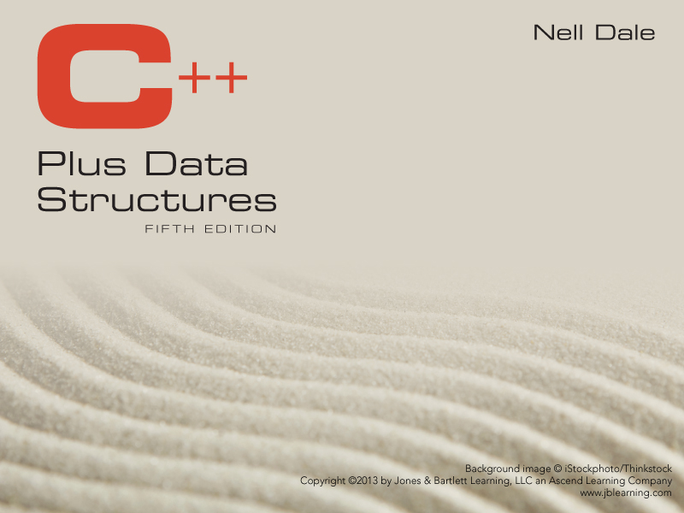
Chapter 9
Priority Queues, Heaps, Graphs, and Sets

Slide 2
Priority Queue
Queue
Enque an item
Item returned has been in the queue the longest amount of time.
Priority Queue
Enque a pair <item, priority>
Item returned has the highest priority.

Slide 3
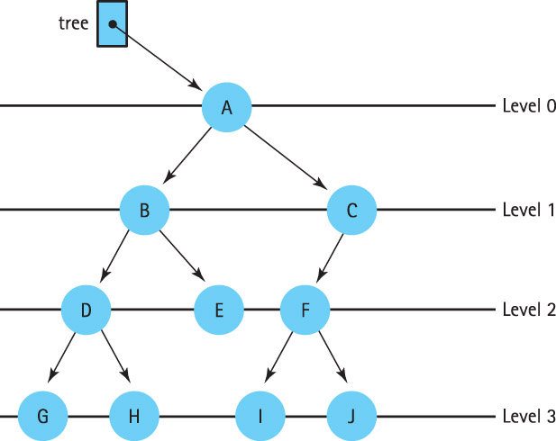

Slide 4
What is a Heap?
A heap is a binary tree that satisfies these
special SHAPE and ORDER properties:
Its shape must be a complete binary tree.
For each node in the heap, the value stored in that node is greater than or equal to the value in each of its children.

Slide 5
Are these Both Heaps?
treePtr
C
50
A
T
20
30
18
10

Slide 6
Is this a Heap?
tree
70
60
12
40
30
8
10

Slide 7
Where is the Largest Element in a Heap Always Found?
tree
70
60
12
40
30
8

Slide 8
We Can Number the Nodes Left to Right by Level This Way
tree
70
0
60
1
12
2
40
3
30
4
8
5

Slide 9
And use the Numbers as Array Indexes to Store the Trees
tree.nodes
[ 0 ]
[ 1 ]
[ 2 ]
[ 3 ]
[ 4 ]
[ 5 ]
[ 6 ]
70
60
12
40
30
8
tree
70
0
60
1
12
2
40
3
30
4
8
5

Slide 10
// HEAP SPECIFICATION
// Assumes ItemType is either a built-in simple data
// type or a class with overloaded relational operators.
template< class ItemType >
struct HeapType
{
void ReheapDown ( int root , int bottom ) ;
void ReheapUp ( int root, int bottom ) ;
ItemType* elements; //ARRAY to be allocated dynamically
int numElements ;
};

Slide 11
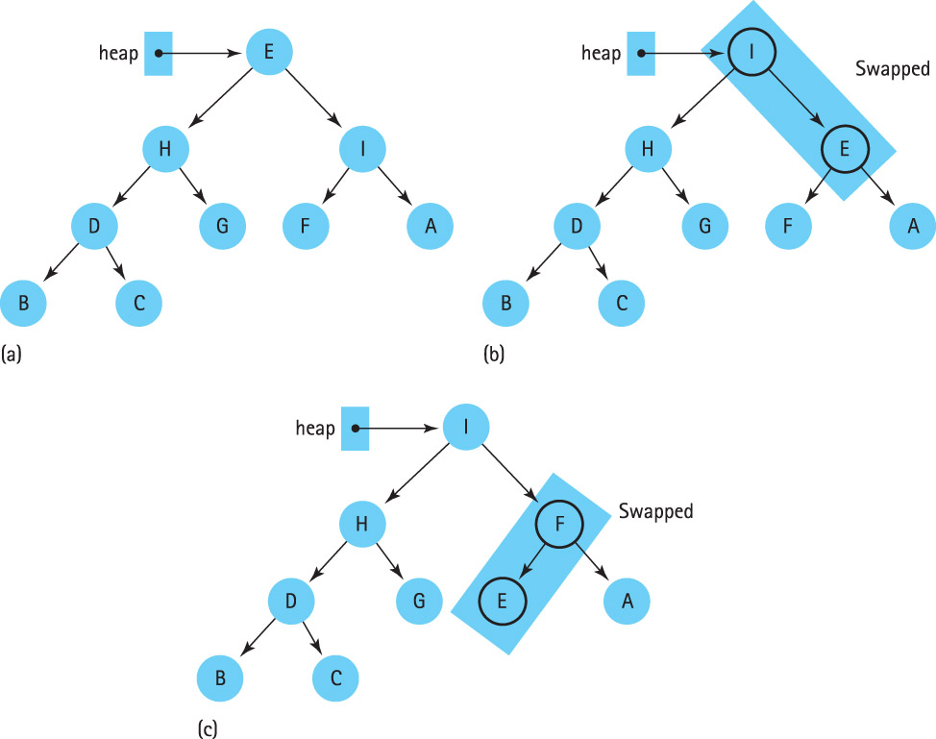

Slide 12
ReheapDown
// IMPLEMENTATION OF RECURSIVE HEAP MEMBER FUNCTIONS
template< class ItemType >
void HeapType<ItemType>::ReheapDown ( int root, int bottom )
// Pre: root is the index of the node that may violate the
// heap order property
// Post: Heap order property is restored between root and bottom
{
int maxChild ;
int rightChild ;
int leftChild ;
leftChild = root * 2 + 1 ;
rightChild = root * 2 + 2 ;

Slide 13
ReheapDown (cont)
if ( leftChild <= bottom ) // ReheapDown continued
{
if ( leftChild == bottom )
maxChild = leftChld;
else
{
if (elements [ leftChild ] <= elements [ rightChild ] )
maxChild = rightChild;
else
maxChild = leftChild;
}
if ( elements [ root ] < elements [ maxChild ] )
{
Swap ( elements [ root ] , elements [ maxChild ] );
ReheapDown ( maxChild, bottom ) ;
}
}
}

Slide 14
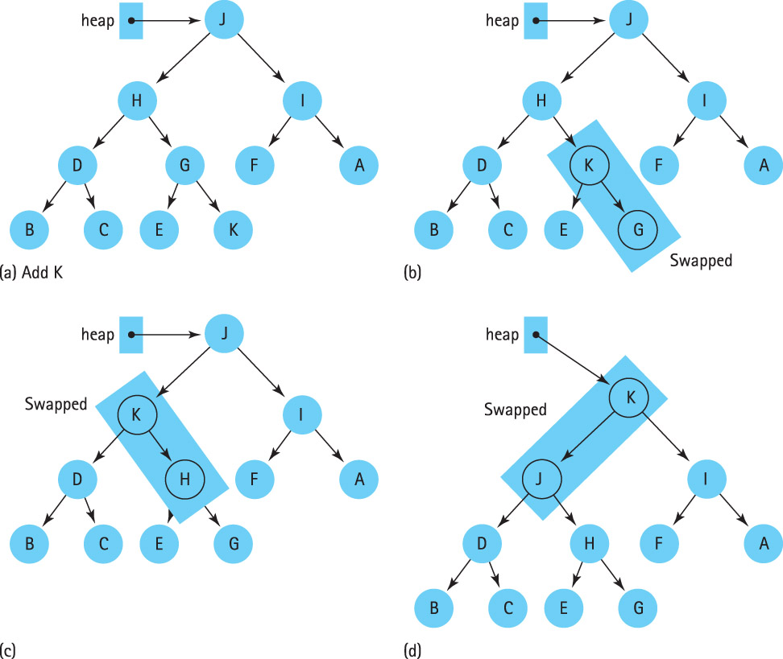

Slide 15
// IMPLEMENTATION continued
template< class ItemType >
void HeapType<ItemType>::ReheapUp ( int root, int bottom )
// Pre: bottom is the index of the node that may violate the heap
// order property. The order property is satisfied from root to
// next-to-last node.
// Post: Heap order property is restored between root and bottom
{
int parent ;
if ( bottom > root )
{
parent = ( bottom - 1 ) / 2;
if ( elements [ parent ] < elements [ bottom ] )
{
Swap ( elements [ parent ], elements [ bottom ] );
ReheapUp ( root, parent );
}
}
}

Slide 16
Priority Queue
A priority queue is an ADT with the property that only the highest-priority element can be accessed at any time.

Slide 17
ADT Priority Queue Operations
Transformers
MakeEmpty
Enqueue
Dequeue
Observers
IsEmpty
IsFull
change state
observe state

Slide 18
Implementation Level
There are many ways to implement a priority queue
An unsorted List- dequeuing would require searching through the entire list
An Array-Based Sorted List- Enqueuing is expensive
A Reference-Based Sorted List- Enqueuing again is 0(N)
A Binary Search Tree- On average, 0(log₂N) steps for both enqueue and dequeue
A Heap- guarantees 0(log₂N) steps, even in the worst case

Slide 19
Class PQType Declaration
class FullPQ(){};
class EmptyPQ(){};
template<class ItemType>
class PQType
{
public:
PQType(int);
~PQType();
void MakeEmpty();
bool IsEmpty() const;
bool IsFull() const;
void Enqueue(ItemType newItem);
void Dequeue(ItemType& item);
private:
int length;
HeapType<ItemType> items;
int maxItems;
};

Slide 20
Class PQType Function Definitions
template<class ItemType>
PQType<ItemType>::PQType(int max)
{
maxItems = max;
items.elements = new ItemType[max];
length = 0;
}
template<class ItemType>
void PQType<ItemType>::MakeEmpty()
{
length = 0;
}
template<class ItemType>
PQType<ItemType>::~PQType()
{
delete [] items.elements;
}

Slide 21
Class PQType Function Definitions
Dequeue
Set item to root element from queue
Move last leaf element into root position
Decrement length
items.ReheapDown(0, length-1)
Enqueue
Increment length
Put newItem in next available position
items.ReheapUp(0, length-1)

Slide 22
Code for Dequeue
template<class ItemType>
void PQType<ItemType>::Dequeue(ItemType& item)
{
if (length == 0)
throw EmptyPQ();
else
{
item = items.elements[0];
items.elements[0] = items.elements[length-1];
length--;
items.ReheapDown(0, length-1);
}
}

Slide 23
Code for Enqueue
template<class ItemType>
void PQType<ItemType>::Enqueue(ItemType newItem)
{
if (length == maxItems)
throw FullPQ();
else
{
length++;
items.elements[length-1] = newItem;
items.ReheapUp(0, length-1);
}
}

Slide 24
Comparison of Priority Queue Implementations
Enqueue
Dequeue
Heap
O(log₂N)
O(log₂N)
Linked List
O(N)
O(1)
Binary Search Tree
Balanced
O(log₂N)
O(log₂N)
Skewed
O(N)
O(N)

Slide 25
Definitions
Graph: A data structure that consists of a set of models and a set of edges that relate the nodes to each other
Vertex: A node in a graph
Edge (arc): A pair of vertices representing a connection between two nodes in a graph
Undirected graph: A graph in which the edges have no direction
Directed graph (digraph): A graph in which each edge is directed from one vertex to another (or the same) vertex

Slide 26
Formally
a graph G is defined as follows:
G = (V,E)
where
V(G) is a finite, nonempty set of vertices
E(G) is a set of edges (written as pairs of vertices)

Slide 27
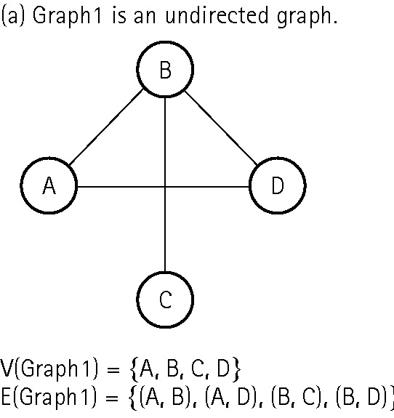
An undirected graph

Slide 28
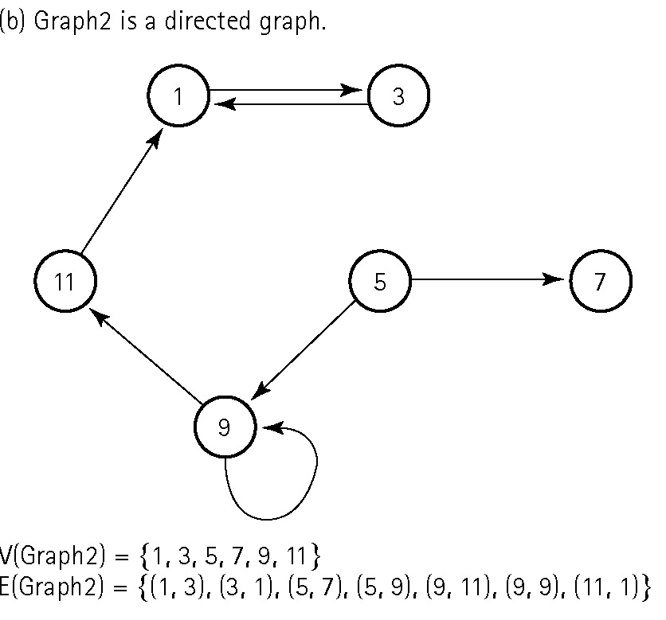
A directed graph

Slide 29
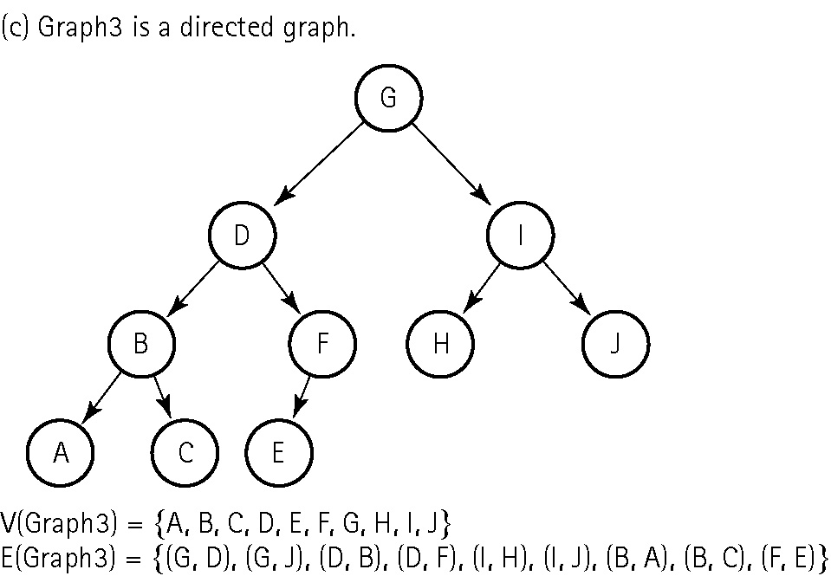
A directed graph

Slide 30
More Definitions
Adjacent vertices: Two vertices in a graph that are connected by an edge
Path: A sequence of vertices that connects two nodes in a graph
Complete graph: A graph in which every vertex is directly connected to every other vertex
Weighted graph: A graph in which each edge carries a value

Slide 31
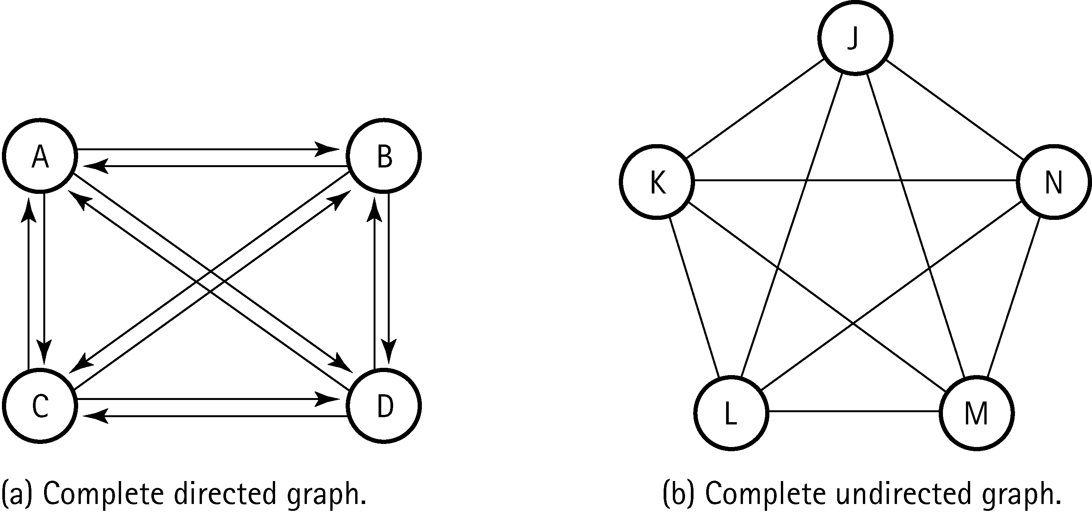
Two complete graphs

Slide 32
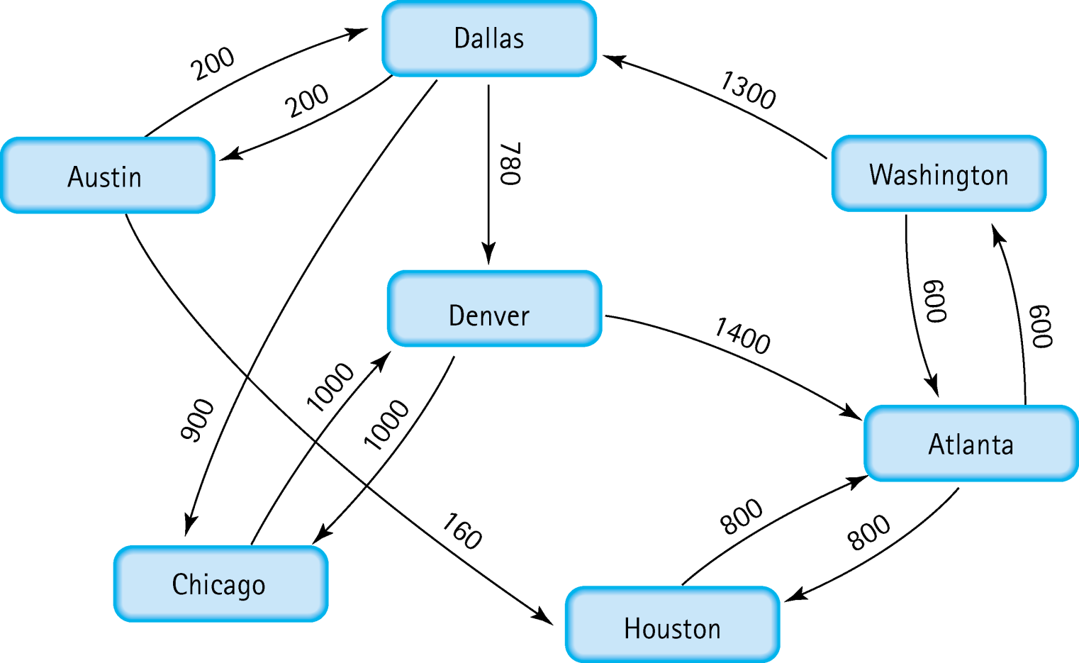
A weighted graph

Slide 33
Definitions
Depth-first search algorithm: Visit all the nodes
in a branch to its deepest point before moving up
Breadth-first search algorithm: Visit all the nodes on one level before going to the next level
Single-source shortest-path algorithm: An algorithm that displays the shortest path from a designated starting node to every other node in the graph

Slide 34
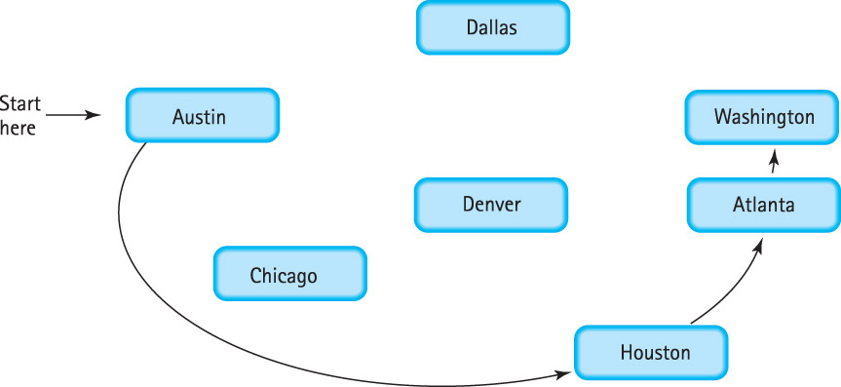
Depth First Search: Follow Down

Slide 35
Depth First Uses Stack

Slide 36
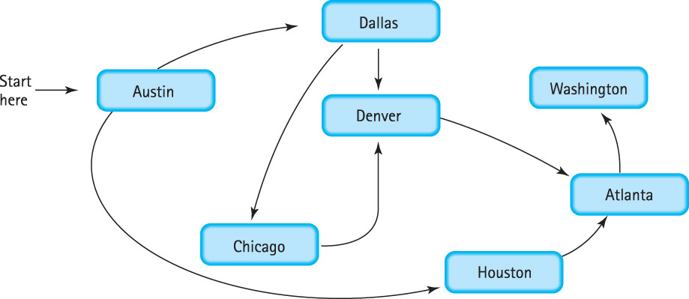
Breadth First: Follow Across

Slide 37
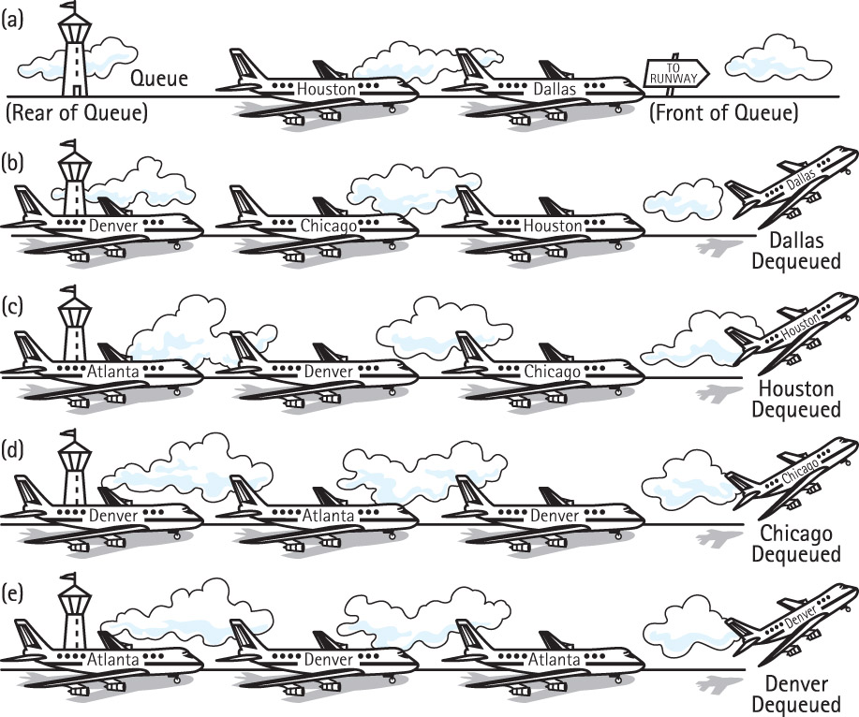
Breadth First Uses Queue

Slide 38
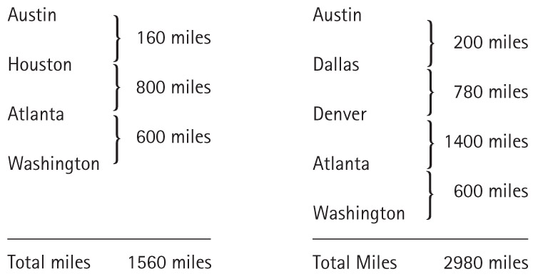
Single Source Shortest Path

Slide 39
Single Source Shortest Path
What does “shortest” mean?
What data structure should you use?

Slide 40
Array-Based Implementation
Adjacency Matrix: for a graph with N nodes, and N by N table that shows the existence (and weights) of all edges in the graph

Slide 41
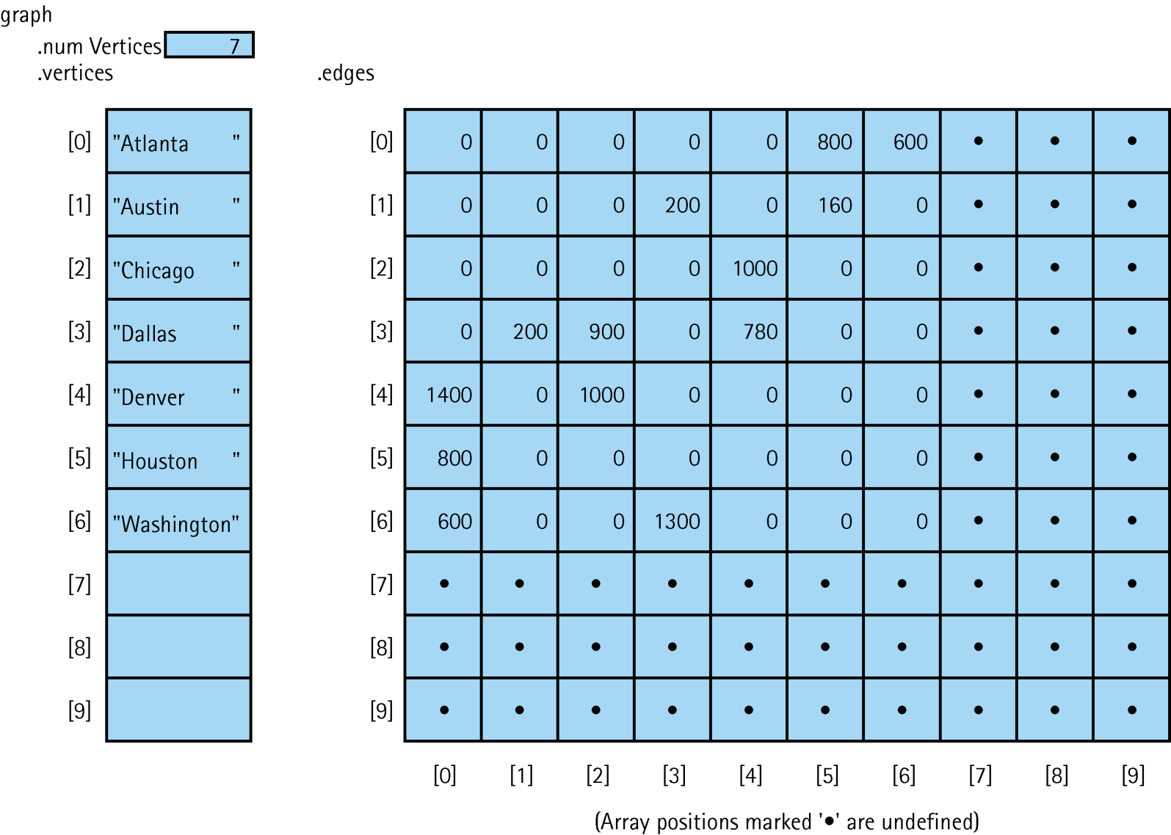
Adjacency Matrix for Flight Connections

Slide 42
Linked Implementation
Adjacency List: A linked list that identifies all the vertices to which a particular vertex is connected; each vertex has its own adjacency list

Slide 43
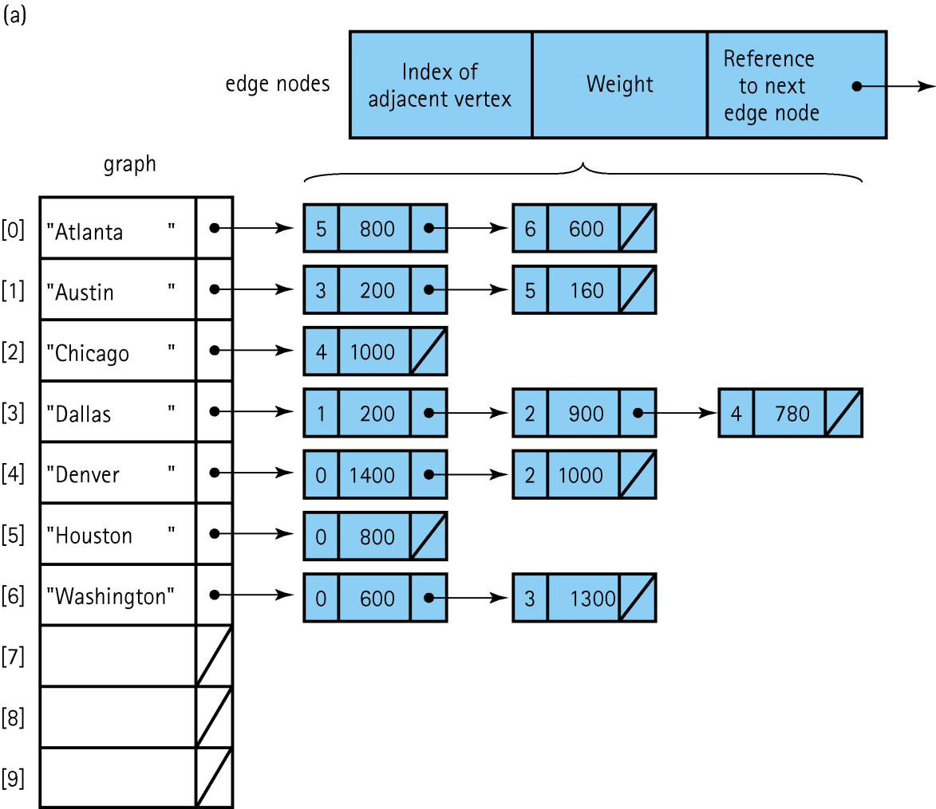
Adjacency List Representation of Graphs

Slide 44
ADT Set Definitions
Base type: The type of the items in the set
Cardinality: The number of items in a set
Cardinality of the base type: The number of items in
the base type
Union of two sets: A set made up of all the items in
either sets
Intersection of two sets: A set made up of all the
items in both sets
Difference of two sets: A set made up of all the items
in the first set that are not in the second set

Slide 45
Beware: At the Logical Level
Sets can not contain duplicates. Storing an item that is already in the set does not change the set.
If an item is not in a set, deleting that item from the set does not change the set.
Sets are not ordered.

Slide 46
Implementing Sets
Explicit implementation (Bit vector)
Each item in the base type has a representation
in each instance of a set. The representation is
either true (item is in the set) or false (item is not
in the set).
Space is proportional to the cardinality of the
base type.
Algorithms use Boolean operations.

Slide 47
Implementing Sets (cont.)
Implicit implementation (List)
The items in an instance of a set are on a list
that represents the set. Those items that are not on the list are not in the set.
Space is proportional to the cardinality of the
set instance.
Algorithms use ADT List operations.

Slide 48
Explain:
If sets are not ordered, why is the SortedList ADT a better choice as the implementation structure for the implicit representation?

